Slide 1
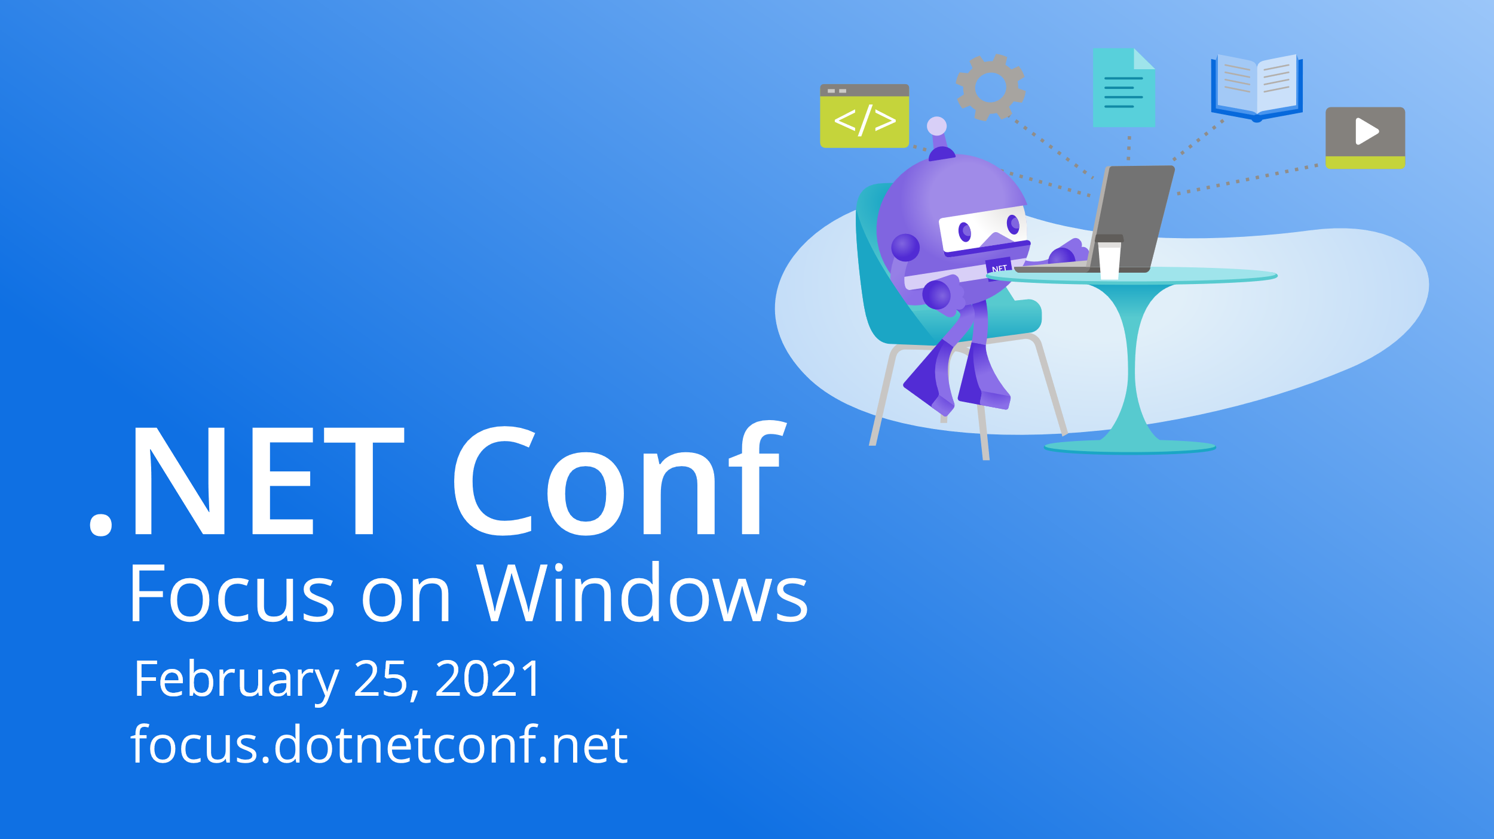

Slide 2


Building .NET Hybrid Apps with Blazor
Daniel Roth

Slide 3








Blazor: Full stack web apps with .NET
ASP.NET Core
Blazor
JS

Slide 4
Part of the ASP.NET Core family
Web UI
Services
MVC
Razor Pages
HTTP APIs
SignalR
SPA
Blazor
Worker
gRPC
Notes:
ASP.NET Core comes with everything you need to build beautiful web UI and powerful backend services. The addition of Blazor to ASP.NET Core expands the reach of your .NET web apps to the client.

Slide 5




Get started with Blazor
Go to https://blazor.net
Install the .NET SDK
Visual Studio
Visual Studio for Mac
Visual Studio Code
+ C# extension

Slide 6
Demo: Your first Blazor app

Slide 7


Startup company uses .NET, Visual Studio and Azure to provide an easy-to-use, affordable, and secure platform for end-of-life planning.
“Using Blazor gave our small development team a huge advantage, enabling the same people to build both the front end and the back end of our solution. We were intimately familiar with the back-end services we had built, so we were able to use them on the front end much faster. I’d estimate that it cut our development time in half”
Ken Myers, Chief Technology Officer, The Postage
Notes:
The Postage is a Startup Company created around an application that could help people with end-of life planning. The founder and CEO had lost 3 family members in a very short time period and she wanted to create an affordable solution for people so they could spend time grieving, not chasing down the massive amounts of paperwork. They used .NET and Visual Studio to build a solution using ASP.NET, Blazor, Xamarin and Azure to rapidly create a secure solution. They were able to save time and personnel cost using .NET end-to-end because they could develop all the pieces using C# as well as reducing the amount of code they would have had to write.
Roll video:

Slide 8
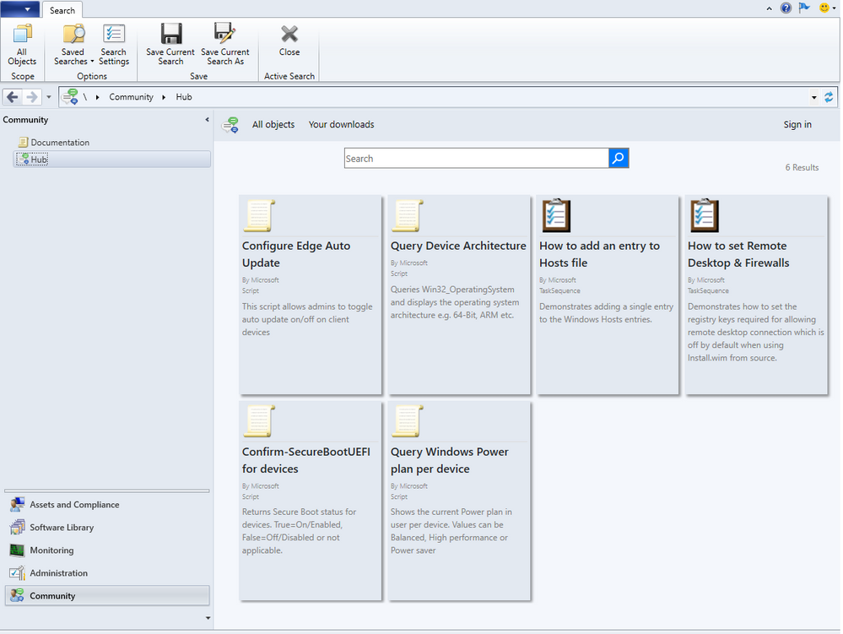
Microsoft Endpoint Manager Community Hub
A place where IT Admins can share scripts, reports and other management objects with each other.
Common Azure-hosted service backed by GitHub. Blazor Server UI, hosted in a WPF client with an embedded web view control.

Slide 9

?
?
?

Slide 10

Hybrid apps
Native desktop app
Web view
Web view
Native mobile app

Slide 11
Hybrid app benefits
Reuse existing web development skills and code
Access to all the native capabilities of the device
Mix native & web UI
Reduce app development time

Slide 12



Hybrid apps with .NET & Blazor
Native desktop app
Web view
Web view
Blazor
.NET
Blazor
.NET
Native mobile app

Slide 13
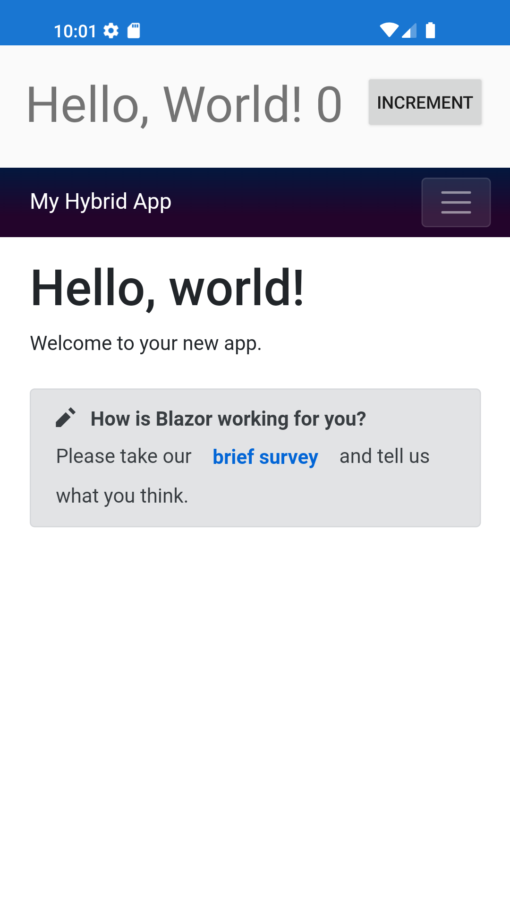
Mobile Blazor Bindings
Blazor components run natively
Rendered to a web view through a local interop channel
Access native functionality directly through .NET APIs
Mix native and web UI
Currently experimental
https://aka.ms/mobile-blazor-bindings

Slide 14
Demo: Blazor hybrid apps

Slide 15




.NET Multi-platform App UI
.NET 6
Cross-platform, native UI
Single project system, single codebase
Deploy to multiple devices, mobile & desktop
General availability in .NET 6
.NET Multi-platform App UI
WinUI
Mac Catalyst
iOS
Android
macOS
iOS
github.com/dotnet/maui
Notes:
We’re making progress on .NET Multi-platform App UI that we announced almost a year ago at Build 2020. It will help you deliver performant, beautiful and consistent app experiences across various platforms and devices, and allow you to share code across your mobile and desktop apps. .NET MAUI under the hood uses technologies out there today for building native apps on Windows with WinUI, Mac Catalyst for macOS, and of course, iOS and Android. .NET MAUI abstracts all those frameworks into a single framework built on .NET 6.
<CLICK>
That means it will allow you to build these apps for any device from a single codebase and project system.
<CLICK>
And that includes desktop and mobile across operating systems, Windows, macOS, iOS and Android.
<CLICK>
It will be part of the unified .NET in the .NET 6 timeframe
<CLICK>
and preview 1 dropped last week so you can go check it out!

Slide 16




Blazor hybrid apps with .NET Multi-platform App UI
Blazor
Reuse UI components across native & web
Mix & match web and native UI
Directly access native device functionality
Cross-platform mobile & desktop apps
(primary focus on desktop for .NET 6)
.NET Multi-platform App UI
WinUI
Mac Catalyst
iOS
Android
macOS
iOS
github.com/dotnet/maui
Notes:
I’m excited to announce .NET Multi-platform App UI, or just .NET MAUI.
<CLICK>
It is a cross-platform, native UI stack so you’ll get great performance on any device.
<CLICK>
It will allow you to build these apps for any device from a single codebase and project system
<CLICK>
And that includes desktop and mobile across operating systems, like Windows, MacOS, iOS and Android.
<CLICK>
This is the evolution of Xamarin technology, building on Xamarin.Forms and expanding that to cross-platform desktop scenarios.
<CLICK>
It will be part of the unified .NET in the .NET 6 timeframe with previews available end of this year. You’ll see us working on it in the open on GitHub.

Slide 17



Summary
Build full stack web apps with ASP.NET Core & Blazor
Get the best of native & the web with hybrid apps
Support for cross-platform hybrid apps coming in .NET 6 with .NET Multi-platform App UI & Blazor
Previews coming soon!

Slide 18

Thanks for joining!
Ask your questions live on Twitter #dotNETConf

